Slide 1
Introduction to Spring Batch
Mario-Mihai Mateaș
Application Developer
mateasmario@ibm.com
0783 017 883

Slide 2
Contents
1 About batch jobs
What is a batch job?
What is Spring Batch?
2 Spring Batch Architecture
3 Implementing a job
Using chunk-oriented processing
Using tasklets
4 Running a job
Command-line arguments
Web interface
Job Parameters
5 Conclusions & Questions
Introduction to Spring Batch

Slide 3
What is a batch job?
A batch job is a series of steps that get executed without requiring any interaction from the user.
Batch jobs are typically used for tasks that involve large scale data processing. The data gets collected during the day, while the job runs outside working hours (usually at night).
Introduction to Spring Batch

Slide 4


What is Spring Batch?
Spring Batch is a way of implementing custom batch jobs, making use of Spring Framework’s benefits.
Spring Framework’s capabilities include dependency injection and transaction management.
Introduction to Spring Batch

Slide 5
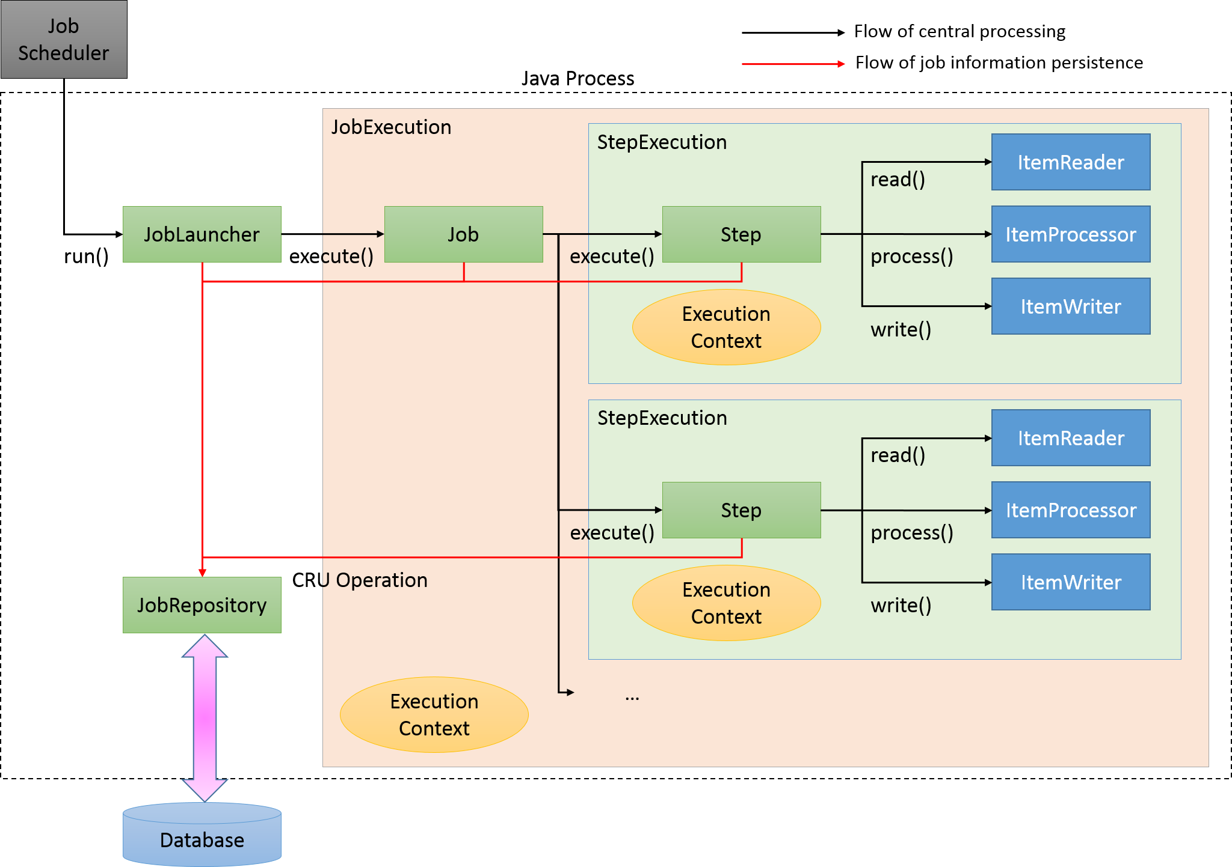
Architecture of Spring Batch
Introduction to Spring Batch

Slide 6
Steps
Spring Batch jobs can contain one or multiple steps, representing specific tasks that are executed during the job’s runtime.
e.g. Extracting e-mail addresses from the table of users that need to pay their subscription and sending them a reminder.
Types of steps in Spring Batch:
Chunk-oriented
Tasklet
Introduction to Spring Batch

Slide 7
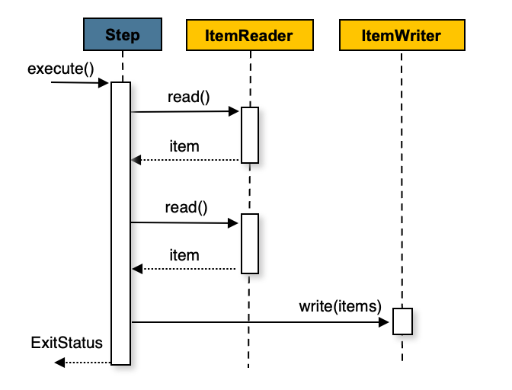
The “chunky” approach
Chunk-oriented steps have a fixed structure for their logic and consist of:
a reader
a processor
a writer
ItemReader
ItemProcessor
ItemWriter
Data is being read from a source (database, JSON files, XML files, etc.)
Data is being processed (update certain values, delete unnecessary rows, remove sensitive data)
Data is being written to a source (database, messaging provider, e-mail, external file, etc.)
Introduction to Spring Batch

Slide 8
Existing implementations that can be used inside Spring Batch jobs
Reader
Writer
FlatFileItemReader
JdbcCursorItemReader
MongoItemReader
JsonItemReader
SimpleMailMessageItemWriter
JsonFileItemWriter
HibernateItemWriter
KeyValueItemWriter
JdbcBatchItemWriter
Processor?
Spring Batch does not offer so many implementations of the ItemProcessor.
Introduction to Spring Batch

Slide 9
The “Tasklet” approach
If the typical read-process-write tactic is too restrictive, a custom step can be implemented, without any contract that needs to be respected.
A Tasklet step allows the developer to write their own logic, and manually notify Spring Batch if the step has failed or completed successfully.
Introduction to Spring Batch

Slide 10
Spring Boot
In this tutorial, we will use Spring Boot to simplify the entire development process.
Spring Boot offers us several perks such as automatic configuration of datasources and the possibility to expose our batch job via a REST API.
Of course, batch jobs can also be implemented using raw Spring.
Introduction to Spring Batch

Slide 11
Basic Setup
Maven pom.xml File
<dependency>
<groupId>org.springframework.boot</groupId>
<artifactId>spring-boot-starter-batch</artifactId>
</dependency>
You will also need to configure a DataSource (for the JobRepository).
Bean Config Class
For raw Spring applications, the batch configuration class can also be annotated with @EnableBatchProcessing, which automatically configures the beans required for running jobs inside a Spring application (e.g. the JobRepository bean).
@Configuration
public class BatchConfiguration {
// Job and step definitions go here
}
Introduction to Spring Batch

Slide 12
Implementing a chunk-oriented job
@Bean
public Job customJob() {
return new JobBuilder(“customJob”, jobRepository)
.start(customStep())
.next(…) // …
.build();
}
@Bean
public Step customStep() {
return new StepBuilder(“customStep”, jobRepository)
.<InputType, OutputType> chunk(3, platformTransactionManager)
.reader(itemReader())
.processor(itemProcessor())
.writer(itemWriter())
.build();
}
Introduction to Spring Batch

Slide 13
Implementing a chunk-oriented job #2
CSV Item Reader
Custom Item Processor
@Bean
public FlatFileItemReader<T> itemReader() {
return new FlatFileItemReaderBuilder<T>()
.name(“itemReader”)
.delimited()
.delimiter(‘,’)
.names(“firstColumn”, “secondColumn”)
.targetType(T.class)
.resource(customFile)
.build();
}
@Bean
public ItemProcessor<T, K> itemProcessor() {
return new ItemProcessor<T, K>() {
public K process(T t) throws Exception {
// process item
return new K(…);
}
}
}
@Bean
public ItemWriter<K> itemWriter() {
JdbcBatchItemWriter<K> writer = new JdbcBatchItemWriter<>();
writer.setDataSource(dataSource());
writer.setSql(“INSERT INTO CUSTOM_TBL VALUES (:id, :firstName, :lastName)”);
writer.setItemSqlParameterSourceProvider(new BeanPropertyItemSqlParameterSourceProvider<>());
writer.afterPropertiesSet();
return writer;
}
Database Item Writer
Introduction to Spring Batch

Slide 14
XML-based (chunk-oriented) job configuration
<job id=“persist_orders">
<step id=“update_existing_products" next=“insert_new_products“>
<tasklet transaction-manager="transactionManager">
<chunk reader=“existingProductsItemReader" writer=“existingProductsItemWriter"/>
</tasklet>
</step>
<step id=“insert_new_products" next=“insert_new_products“>
<tasklet transaction-manager="transactionManager">
<chunk reader=“newProductsItemReader" writer=“newProductsItemWriter"/>
</tasklet>
</step>
</job>
Introduction to Spring Batch

Slide 15
Implementing a tasklet-based job
@Bean
public Job customJob() {
return new JobBuilder(“customJob”, jobRepository)
.start(customStep())
.next(…) // …
.build();
}
@Bean
public Step customStep() {
return new StepBuilder(“customStep”, jobRepository)
.tasklet(customTasklet) // Autowired
.build();
}
Introduction to Spring Batch

Slide 16
Implementing a tasklet-based job #2
@Component
public class CustomTasklet implements Tasklet {
@Override
public RepeatStatus execute(StepContribution contribution, ChunkContext chunkContext) throws Exception {
// Do something here…
return RepeatStatus.FINISHED;
}
}
Introduction to Spring Batch

Slide 17
Running the job
… using command-line arguments:
(needs a custom implementation of the CommandLineRunner)
java -jar target/<outputJarFile> <jobName> <jobParameter1> <jobParameter2> …
… using a web interface
(through Spring Web)
Introduction to Spring Batch

Slide 18
Job Parameters
… are accessible from Tasklet:
contribution.getStepExecution().getJobParameters();
… but their values can also be injected into writers/readers/processors:
@Bean
public FlatFileItemReader<Order> itemReader(@Value("#{jobParameters}") Map<String, Object> jobParameters) {
// …
}
Introduction to Spring Batch

Slide 19
Thank you for your attention!
Introduction to Spring Batch

